Slide 1
Welcome to the ESTP course
Econometrics for macroeconomic statistics!
Dr. Pim Ouwehand
Dr. Peter Knížat
Prof. dr. Frank Pijpers
Dr. Sebastiaan Tieleman

Slide 2
Course trainers
Dr. Pim Ouwehand (dept. of methodology, CBS)
p.ouwehand@cbs.nl
Dr. Peter Knížat (Statistical Office of the Slovak Republic, Comenius University Bratislava)
peter.knizat@statistics.sk
Prof. Dr. Frank Pijpers (dept. of methodology, CBS)
f.pijpers@cbs.nl
Dr. Sebastiaan Tieleman (dept. of methodology, CBS)
sb.tieleman@cbs.nl

Slide 3
1.1 Welcome and overview of the course
Dr. Pim Ouwehand
October 2026

Slide 4
Motivation
Quest for faster and more accurate economic indicators
… enabling early identification of significant economic changes, and provide insight into economic activity with increased timeliness and granularity
  For example, COVID-19 pandemic in 2020 also resulted in a need for more timely data and this also led to many innovations in National Statistics Institutes to meet user and policy needs in a rapid way
Understanding relations between economic phenomena
Methods for cross sectional data and time series analysis are key to understand the signal within the data

Slide 5
Course objectives
After this course, you know about:
  Common time series models and methods, in-sample and out-sample
  Analysing cross-sectional data.
  Using modern data sources for making nowcasts
... and you will have:
  Practical experience in R with these models
...

Slide 6
Course objectives
Theory and practice
R / Rstudio
Day 1: Fundamentals, in-sample methods
Day 2: Advanced and modern methods, out-of-sample methods

Slide 7
Course programme
Day 1
09:15 – 10:00 | 1.1 | Welcome and overview of the course | Pim Ouwehand
10:00 – 12:30 | 1.2 | Cross-sectional data (including break) | Peter Knížat
12:30 – 13:30 |  | Lunch break (CBS restaurant or shopping center)
13:30 – 14:45 | 1.3 | Time series data and time series analysis | Pim Ouwehand
14:45 – 15:00 |  | Coffee break
15:00 – 16:30 | 1.4 | Trendcycle filters and the business cycle tracer | Sebastiaan Tieleman

Slide 8
Course programme
Day 2
09:00 – 10:45 | 2.1 | Rapid estimates | Pim Ouwehand
10:45 – 11:00 |  | Coffee-break
11:00 – 12:30 | 2.2 | Nowcasting with new data sources | Peter Knížat
12:30 – 13:30 |  | Lunch break
13:30 – 15:30 | 2.3 | Macroeconomic nowcasting (including break) | Frank Pijpers
15:30 – 16:00 | 2.4 | From macroeconometrics to knowledge | Sebastiaan Tieleman
16:00 – 16:30 | 2.5 | Summary and evaluation of the course | Pim Ouwehand

Slide 9
Who are you?
Affiliation / role?
Involved in what econometrics activities at your institution?
How well do you know R?
Expectations? What do you hope to learn?

Slide 10
Cross sectional vs time series data

Slide 11
What is cross sectional data?
Data collected from multiple units (individuals, companies, countries) at a single point in time
Variation accross units
Order of observations doesn’t matter
Observations typically assumed to be independent (e.g., from random sampling)

Slide 12
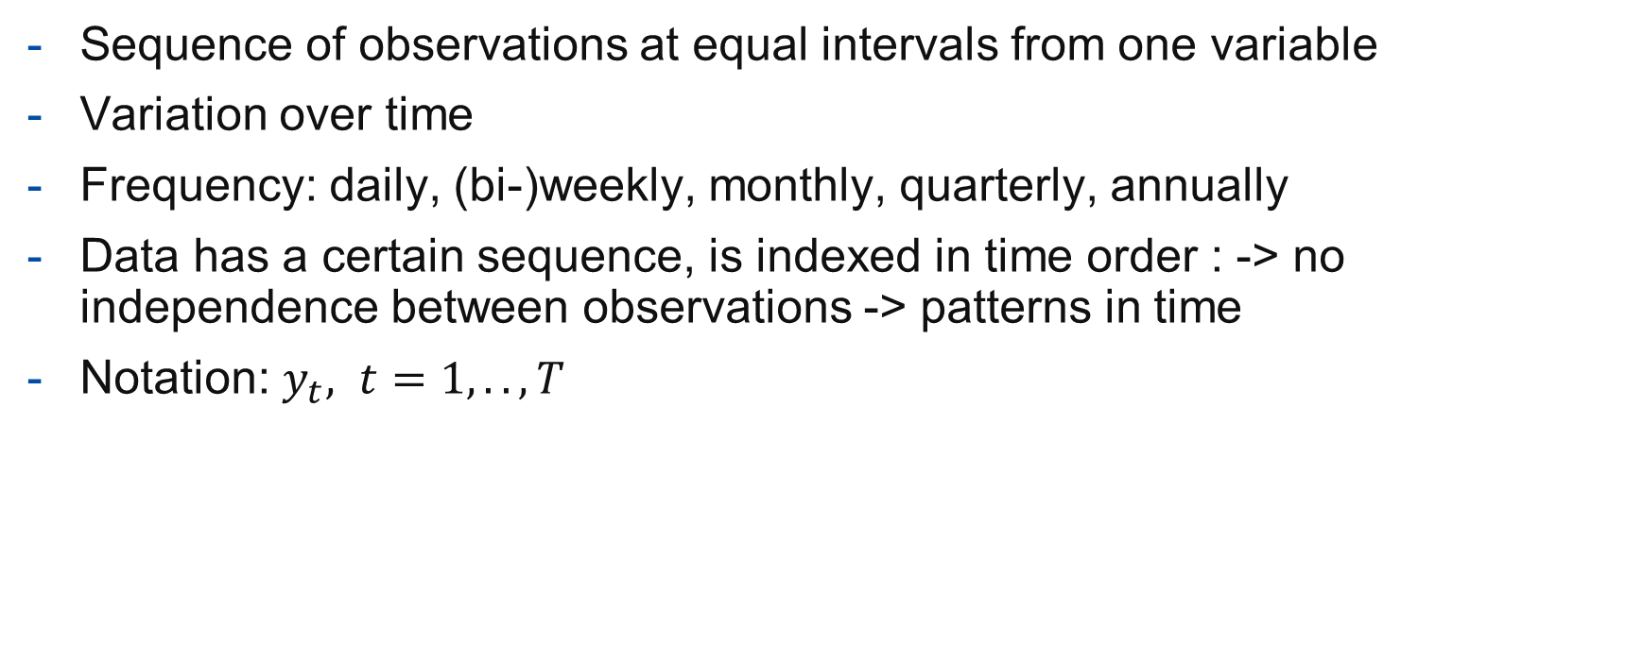
What is a time series?
Sequence of observations at equal intervals from one variable
Variation over time
Frequency: daily, (bi-)weekly, monthly, quarterly, annually
Data has a certain sequence, is indexed in time order : -> no independence between observations -> patterns in time
Notation: $y_{t}, t=1,..,T$

Slide 13
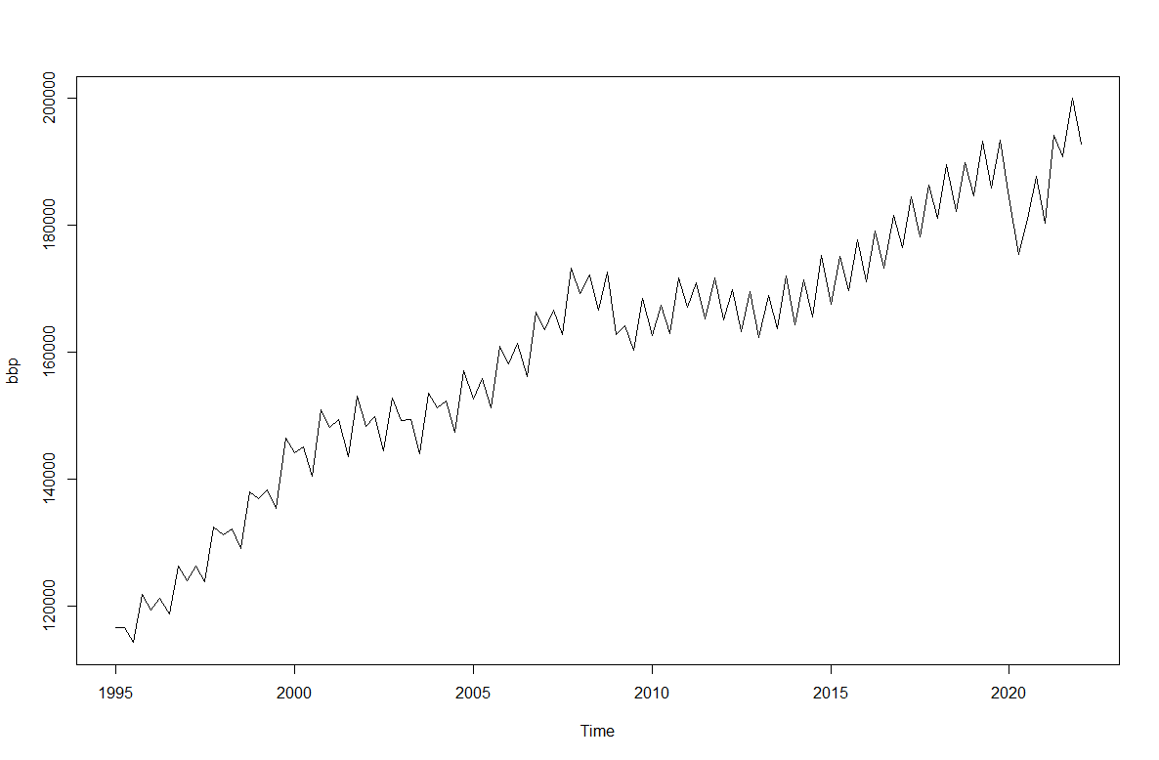
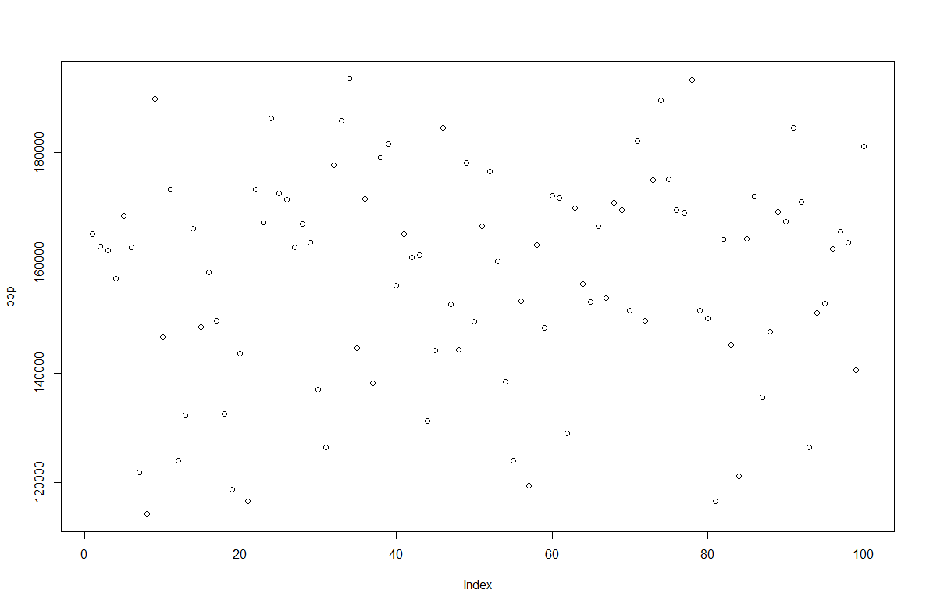
time series vs. cross-sectional
period | value
1995 Q1 | 116638
…
…
2021 Q2 | 194174
2021 Q3 | 190773
2021 Q4 | 199986
2022 Q1 | 192842
index | value
1 | 116638
…
…
97 | 194174
98 | 190773
99 | 199986
100 | 192842

Slide 14
Out-of-sample:
Forecasting, Nowcasting, rapid estimates

Slide 15
The nowcasting problem
Current time
↓
Mixed frequencies
Ragged edges
Q
?
Target
Series
Q
Auxiliary
Series
M
M
→ time

Slide 16
Flash estimates vs nowcasting
Flash estimate (Eurostat/United Nations*, 2017, 2.3)
An early estimate produced and published for an economic variable of interest over the most recent reference period. The flash estimate is normally calculated on the basis of an incomplete information set, however produced using almost the same statistical or econometric models as for regular estimates. Flash estimate models should incorporate hard data as much as possible.
*Handbook on rapid estimates:
https://ec.europa.eu/eurostat/web/products-manuals-and-guidelines/-/KS-GQ-17-008

Slide 17
Nowcasting: definition
Prediction of the present, the very near future and the very recent past (Bańbura et al. , 2010)
Characteristics (Eurostat/United Nations, 2017, 2.3)
Timing: just before or after reference period
Data used: mix of qualitative, current and historical data
Method: specific models
Possibly other data and methods than regular production process.

Slide 18
Nowcasting: possible objectives
Why?
Acceleration
  Increase timeliness (publish earlier)
  Increase frequency (publish more often)
Limitations in availability of data
Modelbased approaches
Time dimension -> Time series models
Auxiliary information -> variables / regressors

Slide 19
Nowcasting: information set
No or incomplete data of target variable for reference period
Use of historical and additional data:
  Partial measurements (part of the population or period)
  Related (both statistical as economical) indicators (incl big data): 'proxies‘
    Possibly available earlier
    Possibly with a higher frequency
  Leading indicators (vs coincident indicators)
  Expert knowledge

Slide 20
Nowcasting vs forecasting
Forecasting
No data from reference period -> complete extrapolation
Out-of-sample
Outside scope of NSI’s (?)
Nowcasting
At least some (partial) data from reference period
In-sample
-> not technique but objective determines if approach is acceptable (at StatNL)

Slide 21
In-sample vs out-of-sample
Current time
↓
Available data
Q
Out-of-sample
In-sample
Q
M
M
→ time

Slide 22
Nowcasting: applications
Increase timeliness/frequency of publications
When availability of data decreases
As emergency scenario / benchmark
Estimation of sub-aggregates
Reduction of revisions
More efficient processes
Margins
-> Trade-off between timeliness and accuracy

Slide 23
Methods
Univariate: autoregressive models, with auxiliary data
  Naïve methods
  Exponential smoothing
  Regression
  Autoregressive distributed lag (ADL)
  ARIMA(X)
  Structural time series models (STM)
  -> ‘simple’ is often effective for short forecast horizons
Multivariate: several series modelled simultaneously
  Vector Autoregressive (VAR)
  Structural Times series Models (STM) (with correlated or shared components)
  Factor models
  Mixed frequency models (MIDAS)
  Bridge models, Chow-Lin (temporal disaggregation)

Slide 24
Exercises
Download and unzip course materials
In Rstudio go to
  ./Exercises/Exercises.Rproj
Select the R-file for the current session, e.g.
1.1 ……….R
1.2 ……….R

Slide 25
Questions so far?

Slide 26
Literature
Time series models:
Box, G. en G. Jenkins (1970), Time Series Analysis: Forecasting and Control, San Francisco: Holden-Day.
Chatfield, C. (2019), The analysis of time series with applications in R
Hamilton, J.D. (1994), Time Series Analysis

Slide 27
Literature
Structural time series models
Commandeur, J.F. and S.J. Koopman (2007), An introduction to state space time series analysis, Oxford University Press
Durbin, J. and S. J. Koopman (2012), Time series analysis by state space methods, Oxford University Press
Harvey (1989), Forecasting, structural time series models and the Kalman filter, Cambridge University Press.

Slide 28
Literature
Seasonal adjustment:
Eurostat (2024), ESS guidelines on seasonal adjustment
Eurostat (2018), Handbook on seasonal adjustment
https://jdemetra-new-documentation.netlify.app/
UNECE (2020), Practical Guide to Seasonal Adjustment with JDemetra+
US Census Bureau (2025), X-13ARIMA-SEATS Reference manual
Eurostat (2020), Guidance on time series treatment in the context of the Covid-19-crisis, Methodological Note

Slide 29
Literature
Forecasting:
Hyndman,R.J., Athanasopulos, G., Forecasting, Principles and Practice, https://otexts.com/fpp3/
Petropoulos et al. (2022), Forecasting: theory and practice, International Journal of Forecasting, Volume 38, Issue 3, Pages 705-871
Makridakis, S., E. Spiliotis, V. Assimakopoulos (2020), The M4 Competition: 100,000 time series and 61 forecasting methods, International Journal of Forecasting, Volume 36, Issue 1, Pages 54-74.
Makridakis, S., E. Spiliotis, V. Assimakopoulos (2022), M5 accuracy competition: Results, findings, and conclusions, International Journal of Forecasting, Volume 38, Issue 4, Pages 1346-1364.

Slide 30
Literature
Nowcasting:
Baldacci, E., Buono, D., Kapetanios, G., Krische, S., Marcellino, M., Mazzi, G.L., Papailias, F. (2016) Big Data and Macroeconomic Nowcasting: from data access to modelling, Eurostat
Eurostat and United Nations (2017), Handbook on rapid estimates
Banbura, M., D. Giannone, and L. Reichlin. 2010. Nowcasting. ECB Working Paper 1275. DOI: http://dx.doi.org/10.2139/ssrn.1717887.

